Slide 1
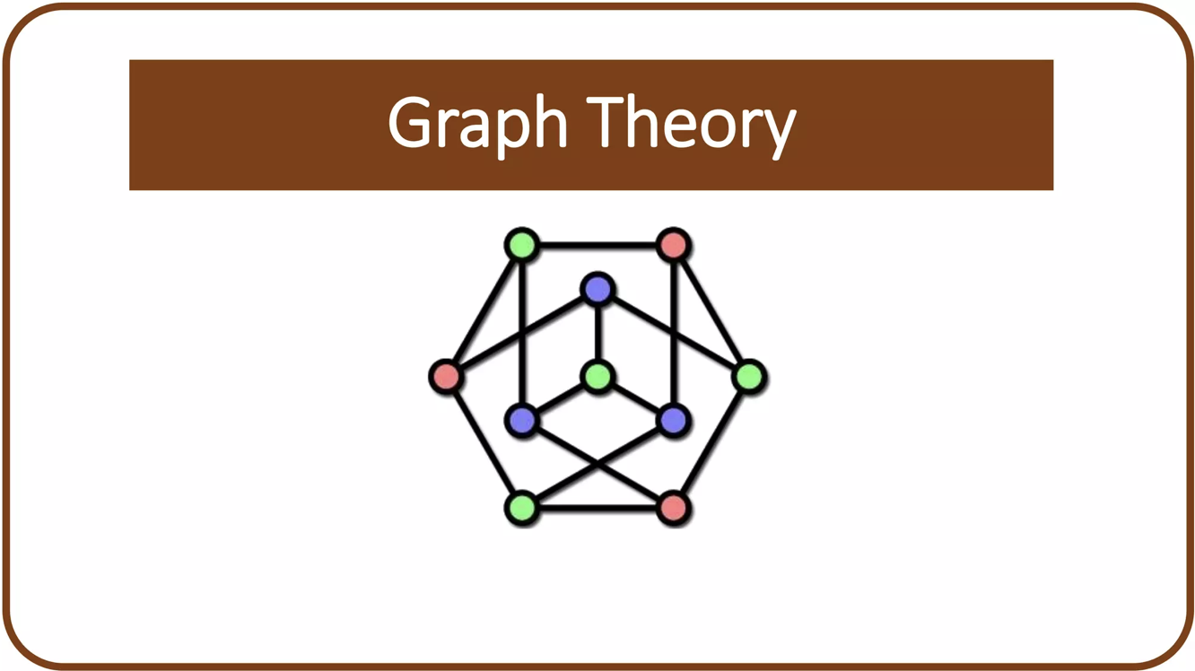

Slide 2
Graph
A Graph is a non-linear data structure consisting of vertices and edges. The vertices are sometimes also referred to as nodes and the edges are lines or arcs that connect any two nodes in the graph. More formally a Graph is composed of a set of vertices (V) and a set of edges (E).
The graph is denoted by G(V,E).

Slide 3
Adjacency Matrix
An adjacency matrix is a way of representing a graph as a matrix. It is particularly useful for representing connections in directed or undirected graphs. For a graph with n vertices, the adjacency matrix is an n×n matrix A where each entry A[i][j] indicates whether there is an edge between vertex i and vertex j .

Slide 4
Directed and Undirected Graph
Undirected Graph:
If there is an edge between vertex ii and vertex jj, then both A[i][j] and A[j][i] are set to 1.
If there is no edge between them, A[i][j]=A[j][i]=This results in a symmetric matrix for undirected graphs.
Directed Graph:
If there is a directed edge from vertex ii to vertex jj, then A[i][j]=
If there is no edge from ii to jj, A[i][j]= 0. This matrix does not have to be symmetric

Slide 5
Brute Force Method
A brute force algorithm for the Traveling Salesman Problem (TSP) is a straightforward but highly intensive method used to find the shortest route that allows a salesman to visit each city once and return to the starting point. The algorithm works by listing all possible tours among the n cities, resulting in n! different routes to evaluate. For each tour, the algorithm calculates the total distance by summing up the distances between consecutive cities. Finally, it identifies the route with the smallest total distance, which is the optimal solution for the TSP. Although simple in concept, this approach quickly becomes impractical as the number of cities increases, due to the exponential growth in possible routes

Slide 6
Limitations of the Brute Force Method
The brute force algorithm for the Traveling Salesman Problem (TSP) is limited because it requires checking every possible route to find the shortest one. As the number of cities increases, the number of possible routes grows extremely quickly, making it impossible to compute within a reasonable time.
For example, with 20 cities, there are trillions of possible routes to evaluate. This makes brute force impractical for larger problems, as it takes far too long to find a solution.
Therefore, other methods are preferred for solving TSP in real-world situations

Slide 7
Given a set of cities and the distance between every pair of cities, the problem is to find the shortest possible route that visits every city exactly once and returns to the starting point. Note the difference between Hamiltonian Cycle and TSP. The Hamiltonian cycle problem is to find if there exists a tour that visits every city exactly once. Here we know that Hamiltonian Tour exists (because the graph is complete) and in fact, many such tours exist, the problem is to find a minimum weight Hamiltonian Cycle.

Slide 8
Hamiltonian Circuits and Paths Circuits and Paths
A Hamiltonian circuit is a circuit that visits every vertex once with no repeats. Being a circuit, it must start and end at the same vertex. A Hamiltonian path also visits every vertex once with no repeats, but does not have to start and end at the same vertex.

Slide 9
MINIMUM SPANNING TREE
A spanning tree is defined as a tree-like subgraph of a connected, undirected graph that includes all the vertices of the graph. Or, to say in Layman's words, it is a subset of the edges of the graph that forms a tree (acyclic) where every node of the graph is a part of the tree.
A minimum spanning tree (MST) is defined as a spanning tree that has the minimum weight among all the possible spanning trees

Slide 10
Greedy Algorithm
Greedy is an algorithmic paradigm that builds up a solution piece by piece, always choosing the next piece that offers the most obvious and immediate benefit. Greedy algorithms are used for optimization problems.
An optimization problem can be solved using Greedy if the problem has the following property:
﻿﻿At every step, we can make a choice that looks best at the moment, and we get the optimal solution to the complete problem.
﻿﻿Some popular Greedy Algorithms are Kruskal's algorithm and Prim's Algorithm

Slide 11
KRUSKAL’S ALGORITHM
In Kruskal's algorithm, sort all edges of the given graph in increasing order. Then it keeps on adding new edges and nodes in the MST if the newly added edge does not form a cycle. It picks the minimum weighted edge at first and the maximum weighted edge at last. Thus we can say that it makes a locally optimal choice in each step in order to find the optimal solution. Hence this is a Greedy Algorithm.

Slide 12
How to find MST using Kruskal's algorithm?
Below are the steps for finding MST using Kruskal's algorithm:
﻿﻿﻿Sort all the edges in non-decreasing order of their weight.
﻿﻿﻿Pick the smallest edge. Check if it forms a cycle with the spanning tree formed so far. If the cycle is not formed, include this edge. Else, discard it.
﻿﻿﻿Repeat step#2 until there are (V-1) edges in the spanning tree.

Slide 13
PRIM’S ALGORITHM
This is also a greedy algorithm. This algorithm has the following workflow:
Start from any vertex, add it to the MST.
Repeatedly choose the minimum-weight edge that connects a vertex in the MST to a vertex outside it.
Continue until all vertices are included in the MST.
Prim's algorithm uses a priority queue to select the minimum edge efficiently, making it useful for applications like image segmentation and optimal routing.

Slide 14
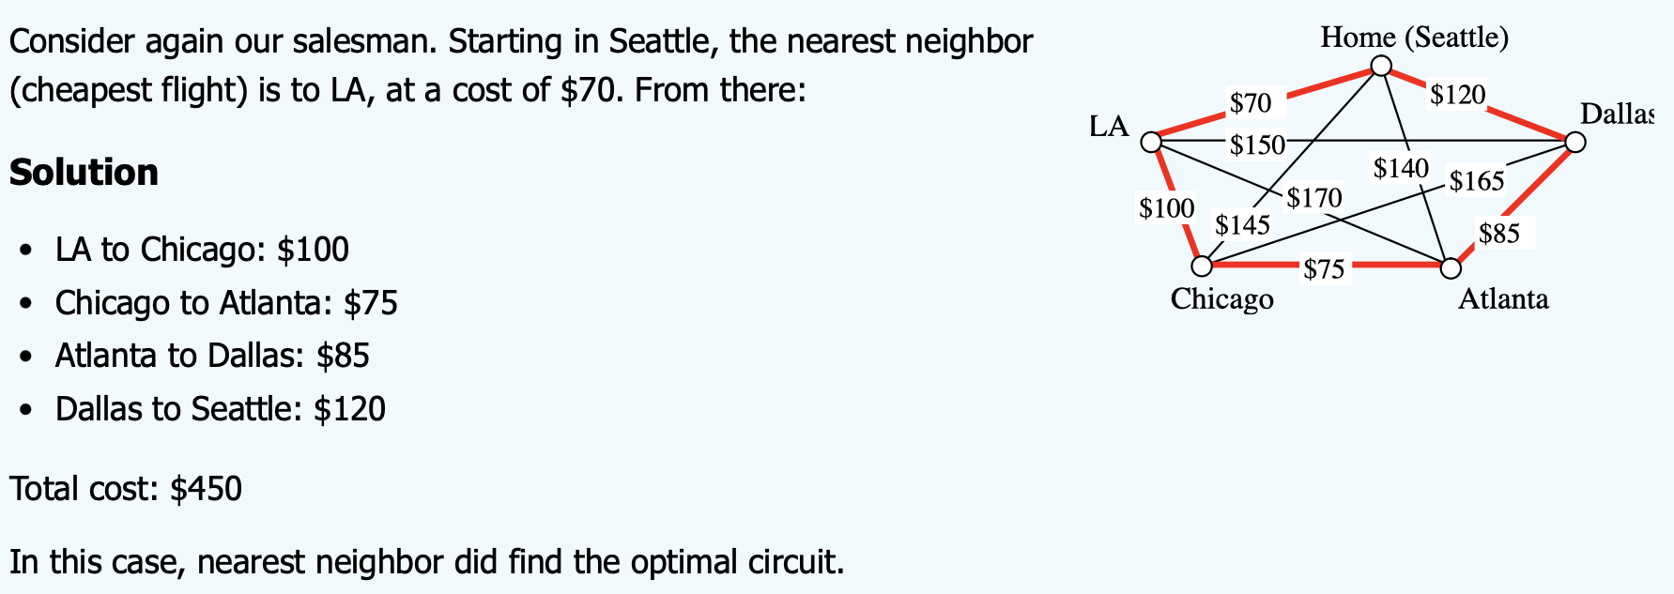

Slide 15
